Slide 1
Human-Computer Interaction
COMS30029
aka #HCI_Theory
Week 2: First Wave
Oussama Metatla and Dan Bennett
Chunk 1: Introduction

Slide 2
Week 2: First Wave
Chunk 1: Introduction
How did people think in the early days of HCI?

Slide 3

Reading
Chapter 4:
PLUS: Choose at least one of…
A more in-depth look at Fitts’ Law
A nice interactive explanation of Fitts’ Law and why it matters https://timmarco.com/fitts/
Meta theory: discussion of theory use in design
Beck & Stolterman: Examining Practical, Everyday Theory Use in Design Research (2016) – in the reading folder
Rogers, Y. (2012). HCI theory: classical,
modern, and contemporary. Synthesis lectures on human-centered informatics, 5(2), 1-129.
Seminal account of why HCI should move past purely “hard” science perspectives (tougher read)
Carroll & Campbell: Softening Up Hard Science: reply to Newell and Card (1986) – in the reading folder

Slide 4
First wave of HCI
1980s-1990s
HCI as an applied science, grounded in lab research
An information processing perspective, from cognitive psychology
Still influential today (though often using more advanced models)

Slide 5
Broad theoretical approaches in the first era
Paradigm: Scientific, grounded in lab based cognitive psychology. Computational, centralized, symbol processing view
Goal: How do individuals make use of computational technologies, and
how can technologies be designed to be more usable, and useful.
Main Approaches to Theory:
Using Isolated Ideas from basic science disciplines
Applying theories from basic science disciplines
Developing new HCI-specific theory, grounded in lab science disciplines

Slide 6
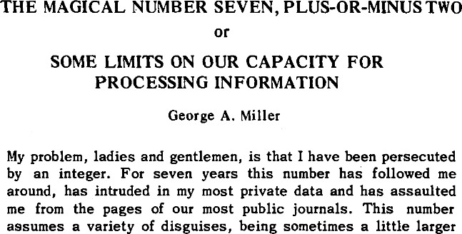
1. Using Isolated Ideas from basic science research
5-9 top level menu items?
5-9 function types?
5-9 colours on screen?
Easy to remember
Lacks detail and discrimination
Not clear how to develop further

Slide 7
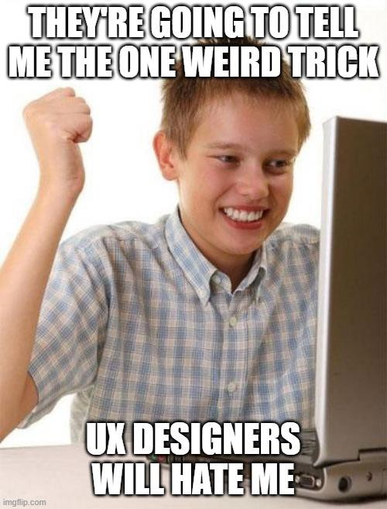
1. Using Isolated Ideas from basic science disciplines

Slide 8
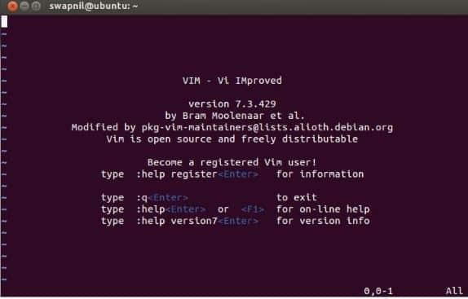
2. Applying theories from basic science disciplines
Paired associate theory used understand how to select command names:
Command names should be familiar and have some natural link with the invoked process
The approach is specific and allows us to refine our approach by reference to the theory

Slide 9
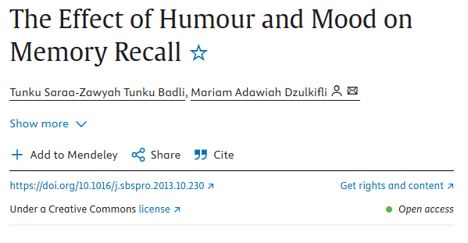
2. Applying theories from basic science disciplines
Paired associate theory
Command names should be familiar and have some natural link with the invoked process
Various factors may affect memorability of command names in different contexts
Many
experiments later
Neat, generalisable rule for design
Complex, specific data which is hard to apply

Slide 10
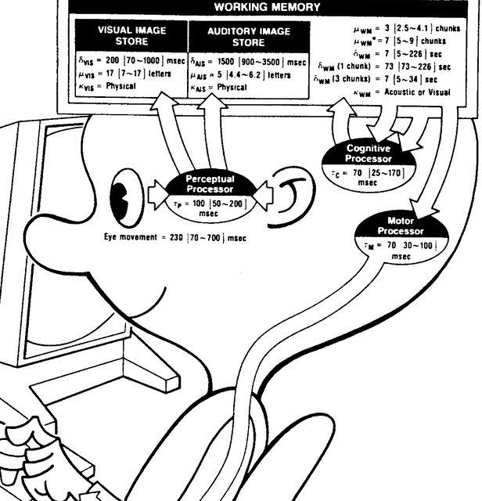
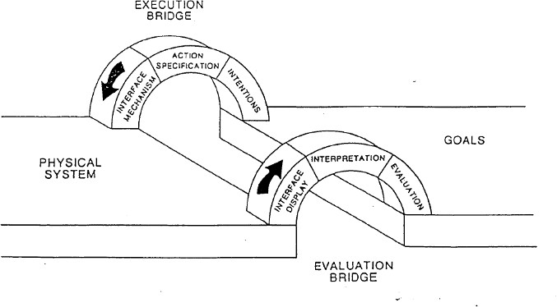
3. Developing new HCI-specific theory, grounded in
lab science disciplines
Cognitive modelling of interaction scenarios
GOMS
Gulfs of Execution and Evaluation

Slide 11
Week 2: First Wave
Chunk 2: GOMS and Fitts’ Law
Mathematical models of user behaviour

Slide 12
GOMS and Fitts’ Law
Fitt’s Law: predicting performance on mouse tasks
GOMS: predicting performance on a range of input tasks (Goals, Operators, Methods and Selection rules)
Both grounded in cognitive psychology
Both expanded and developed in HCI
Narrow, and precise, and focused on particular phenomena

Slide 13
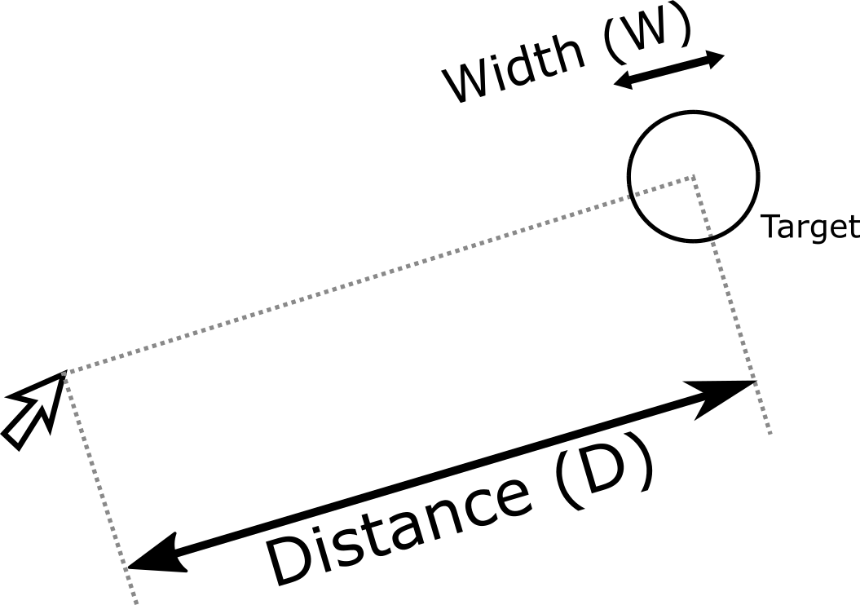
Fitts’ Law: pointing, parameterised!
Originally developed to understand pointing with a finger
HCI adopted and extended to understand mouse, touchscreen use, and other examples of cursor control
Posits a speed-accuracy trade-off in movement towards a target, and quantifies this

Slide 14
Fitts’ Law: pointing, parameterised!
time Index of difficulty
T = a + b log2(2D / W)
“delay” “acceleration”

Slide 15
Fitts’ Law: pointing, parameterised!
Three ways to use Fitt’s Law
High Level qualitative-quantitative
engagement
Mathematical Engagement with the model
3.Further Theory Building
time Index of difficulty
T = a + b log2(2D / W)
“delay” “acceleration”

Slide 16
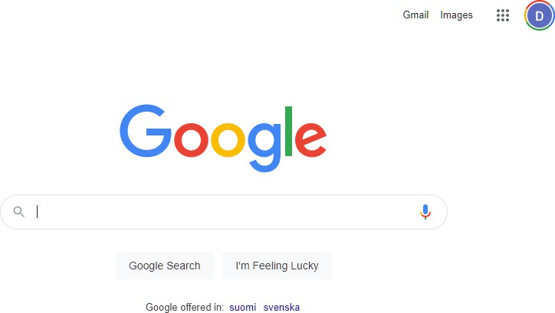
Fitts’ Law: pointing, parameterised!
High Level qualitative-quantitative engagement
Further = harder / slower
So:
  Minimise length of mouse moves
  Control the user’s mouse-path
time Index of difficulty
T = a + b log2(2D / W)
“delay”
“acceleration”

Slide 17
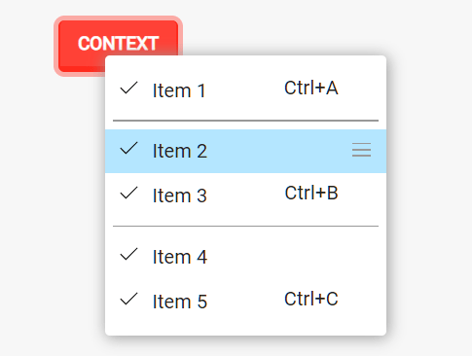
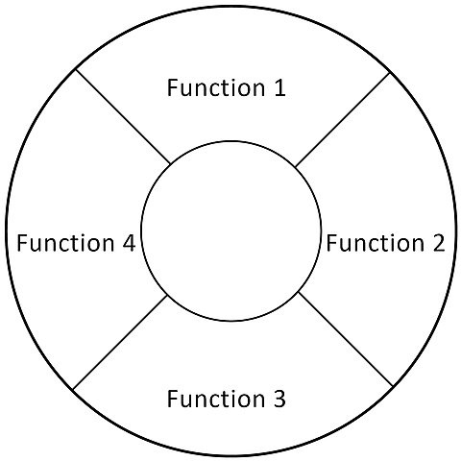
Fitts’ Law: pointing, parameterised!
High Level qualitative-quantitative engagement
Further = harder / slower
So:
  Minimise length of mouse moves
  Control the user’s mouse-path
  Spawn controls close to mouse position
time Index of difficulty
T = a + b log2(2D / W)
“delay”
“acceleration”

Slide 18
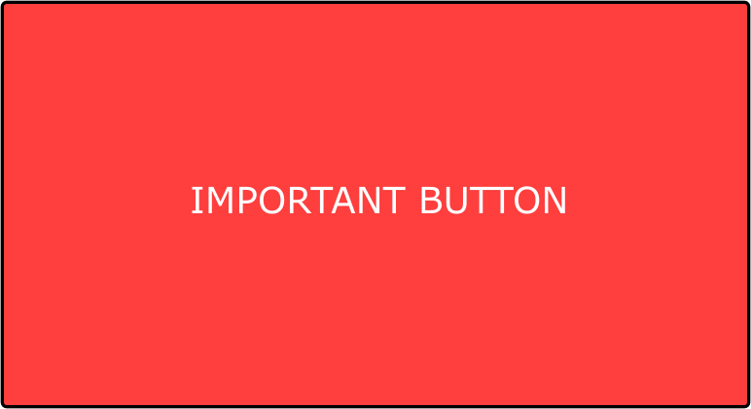
Fitts’ Law: pointing, parameterised!
High Level qualitative-quantitative engagement
bigger = easier
So:
  Make UI elements bigger when time pressure, or risk of error are high
time Index of difficulty
T = a + b log2(2D / W)
“delay”
“acceleration”

Slide 19




Fitts’ Law: pointing, parameterised!
High Level qualitative-quantitative engagement
Alerting the designer to high error rates
  Minimise cost of error
Edges and Corners Are Special: infinite width
time Index of difficulty
T = a + b log2(2D / W)
“delay”
“acceleration”

Slide 20
Fitts’ Law: pointing, parameterised!
Mathematical Engagement
  Build tools to analyse layouts and guide design
  Analyse use of nested vs flat menus
  Calculate times for paths through website
  Create adaptive interfaces?
time Index of difficulty
T = a + b log2(2D / W)
“delay”
“acceleration”

Slide 21


Fitts’ Law: pointing, parameterised!
Further Theory Building
  Does mouse-path efficiency nudge behaviour?
    Easier: encourage purchases?
A GREAT PRODUCT
A GREAT PRODUCT
time Index of difficulty
T = a + b log2(2D / W)
“delay”
“acceleration”

Slide 22
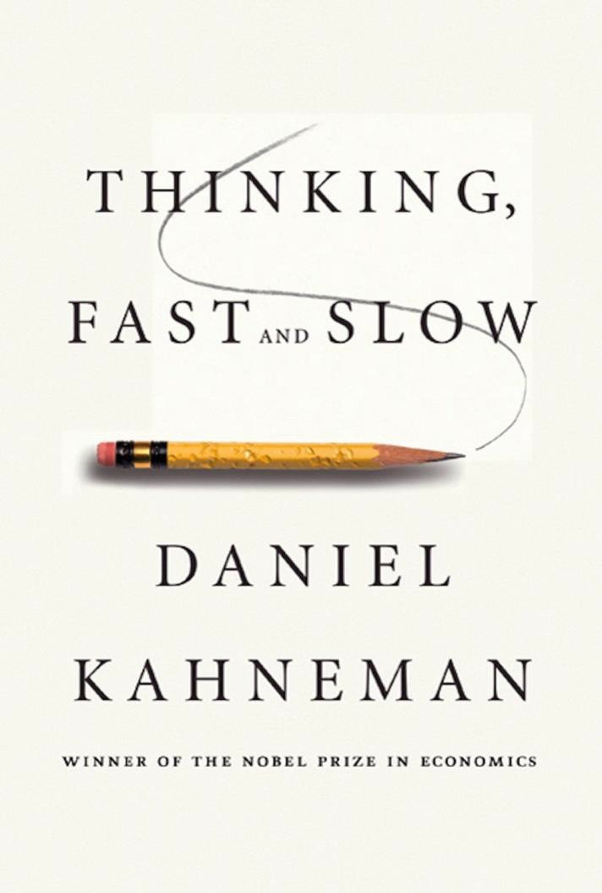

Fitts’ Law: pointing, parameterised!
Further Theory Building
  Does mouse-path efficiency nudge behaviour?
    Easier: encourage purchases?
    Harder: increase thoughtfulness?
Extensions: 3d pointing in VR?
time Index of difficulty
T = a + b log2(2D / W)
“delay”
“acceleration”

Slide 23
READING:
READING OPTION 1:
A Deep Dive Into Fitts’ Law
https://timmarco.com/fitts/
NEXT:
GOMS: Goals Operators Methods and Selection rules

Slide 24

GOMS: Goals Operators Methods and Selection rules
Analyse times for input tasks for a
skilled user
Again, grounded in information processing models from cognitive psychology
Aims to be easy for designers to apply

Slide 25
GOMS: Goals Operators Methods and Selection rules
Decomposes tasks into on atomic actions (operators) and assigns times
Various versions of varying complexity
Simple: KLM-GOMS
Complex: CPM-GOMS

Slide 26
GOMS: Goals Operators Methods and Selection rules
GOALS: what the user wants to do
OPERATORS: individual actions
METHODS: how to combine actions to achieve the goal
SELECTION RULES: how to choose between potential METHODS of the task

Slide 27
GOMS: Goals Operators Methods and Selection rules
Applying GOMS
KLM OPERATORS:
K - press a key
P - point to location on screen with mouse
H - move hands to home position on the keyboard
M - mentally preparing to perform an action
R - system response while the user waits for the system.

Slide 28
GOMS: Goals Operators Methods and Selection rules
GOMS Limitations?
No Fatigue
No Learning (expert users)
No Errors (expert users)
All tasks are goal-directed
Goal is clear at start of the task (no problem solving)

Slide 29
Week 2: First Wave
Chunk 3: Heuristic models, and disagreements with the first wave
More general approaches in the First Wave, and why HCI started to investigate other approaches

Slide 30
GOMS and Fitts’ Law
Grounded in cognitive psychology
Narrow, precise, and predictive
Next: More General, or Heuristic Models
Grounded in cognitive psychology
Broader, generalising, prescriptive
Reading Option 3: Carroll & Campbell: Softening Up Hard Science (1986)

Slide 31
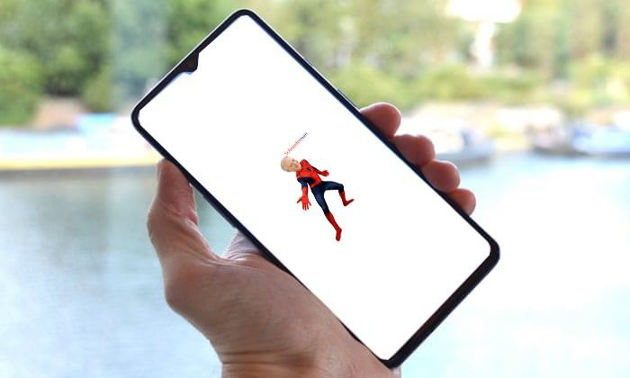

Direct Manipulation: a foundational GUI theory

Slide 32

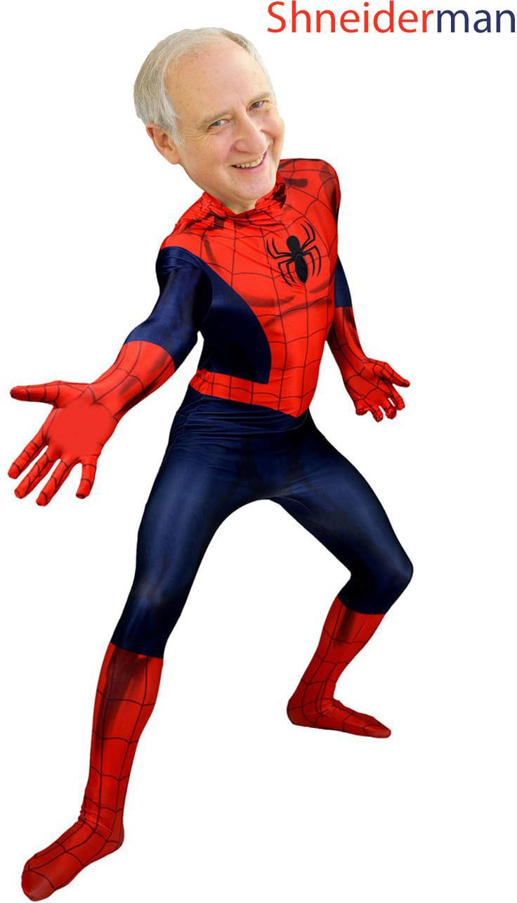
Direct Manipulation: a foundational GUI theory

Slide 33
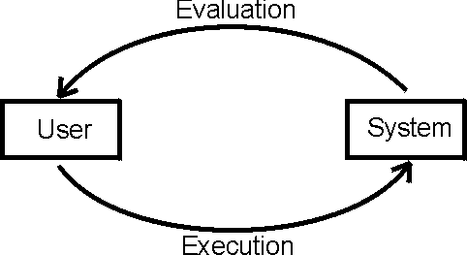
Direct Manipulation: a foundational GUI theory

Slide 34
Gulfs of Execution and Evaluation:
interaction problems and how to solve them

Slide 35


Gulfs of Execution and Evaluation:
interaction problems and how to solve them
System Capabilities
User
Action plans
(Adnan)

Slide 36
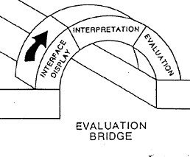
Gulfs of Execution and Evaluation:
interaction problems and how to solve them
User
Action plans
System Capabilities

Slide 37
Gulfs of Execution and Evaluation:
interaction problems and how to solve them
Editing a video: Gulf of Evaluation
Hyper VideoEdit 2097 is only
£134 a month!
Evaluated System State
System has a video editor
Actual System State
Vendor wants to sell you a video editor

Slide 38
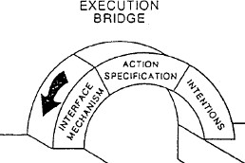
Gulfs of Execution and Evaluation:
interaction problems and how to solve them
User
Action plans
System Capabilities

Slide 39
Gulfs of Execution and Evaluation:
interaction problems and how to solve them
Editing a video: Gulf of Execution
Expected Action Plan
Run video editing app
load the video sections
Select each section of video I want, and put it onto a timeline
Required Action Plan
Install and pay for a video editing app
Install a video conversion program
Set the correct parameters for the
conversion, looking them up on the internet
Run the video editing app
load the video sections into my app
Select each section of video I want, and put it onto a timeline

Slide 40
Gulfs of Execution and Evaluation:
interaction problems and how to solve them
User
Action plans
System Capabilities

Slide 41
Gulfs of Execution as an
Information processing theory?
Gulf of Execution:
Wrong method for the task, mismatch in steps (operators)
GOMS
GOALS: what the user wants to do
OPERATORS: individual actions
METHODS: how to combine actions to achieve the goal
SELECTION RULES: how to choose between potential MODELS of the task

Slide 42
Information processing theories in the First Wave: Assumptions
ALL IN THE BRAIN: all the important stuff is happening via symbol processing in the brain. The body is controlled by the brain without adding too much.
ATEMPORAL: history and order considered minimally relevant, other temporal factors, synchronisation etc. are not considered
ACONTEXTUAL: context is not modelled
COMPOSABLE: Cognitive processes can be broken apart and sections modelled independently without too much loss of accuracy
SIGNAL + NOISE: variability in the process can be treated as noise

Slide 43

Information processing theories in the First Wave
ALL IN THE BRAIN: all the important stuff is happening via symbol processing in the brain. The body is controlled by the brain without adding too much.
ATEMPORAL: history and order considered minimally relevant, other temporal factors, synchronisation etc. are not considered
ACONTEXTUAL: context is not modelled
COMPOSABLE: Cognitive processes can be broken apart and sections modelled independently without too much loss of accuracy
SIGNAL + NOISE: variability in the process can be treated as noise, distributed in a roughly Gaussian manner

Slide 44
What is the practical effect of these differences in
theory? How to choose?
Better fit for phenomenon? Does another theory give a better, more parsimonious account of the interaction we’re observing? Does it explain it better?
Supports Collaboration? helps us understand and be understood by colleagues in another discipline, or another team?
Easy to convert into design? designers can understand and apply the theory to their own practice
Computable, formal? Can we formalise the theory in a model or code, make quantitative predictions, can we use it to build adaptive computer systems?
Other properties? …

Slide 45
Where after the First Wave?
Capturing real world behaviour?
Accounts for interaction in real spaces?
Accounts for social and cultural contexts, and constraints?
Accessible to observation?

Slide 46
Next week…
Week 3: The Second Wave part 1: From cognition to the experiences of bodies

Slide 47
Reading
Chapter 4:
PLUS: Choose at least one of…
A more in-depth look at Fitts’ Law
A nice interactive explanation of Fitts’ Law and why it matters https://timmarco.com/fitts/
Meta theory: discussion of theory use in design
Beck & Stolterman: Examining Practical, Everyday Theory Use in Design Research (2016) – in the reading folder
Rogers, Y. (2012). HCI theory: classical,
modern, and contemporary. Synthesis lectures on human-centered informatics, 5(2), 1-129.
Seminal account of why HCI should move past purely “hard” science perspectives (tougher read)
Carroll & Campbell: Softening Up Hard Science: reply to Newell and Card (1986) – in the reading folder

Slide 48
#HCI
_Theory

